Slide 1


A Measurable Ranking of Pre-trained 3D Models: from Least to Most Powerful
Yujie Chen
2024.5.16
Notes:
Hello everyone, Good morning. My name is Chen Yujie, and I am a Master’s student in Computer Science at Peking University and also a summer intern at Johns Hopkins University. I am very pleased to have the opportunity to introduce to you our summer project: "A Measurable Ranking of Pre-trained 3D Models: From Least to Most Powerful."

Slide 2
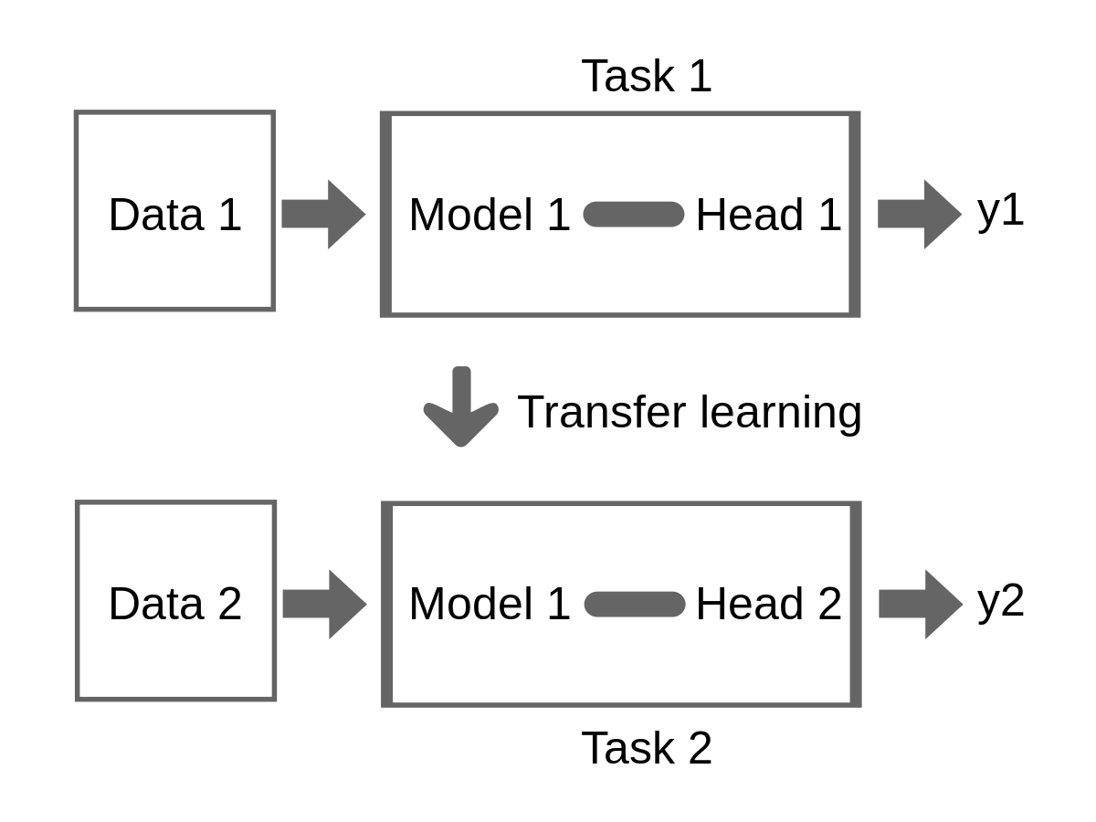
Background
Model transferability refers to how well knowledge from a source task improves target task performance.
Task Relatedness
Data Distribution
Model Architecture
Quality of source data labels
Notes:
1. Task Relatedness
Task relatedness is one of the most critical factors in transfer learning. It refers to the similarity or relevance between the source task and the target task. The higher the relatedness of the tasks, the better the transfer learning performance is likely to be. This relatedness can be examined from the following aspects:
Similarity of Label Space: If the label categories of the two tasks are similar or identical, the model transfer is usually smoother.
Shared Feature Space: If the source and target tasks share many commonalities at the feature level, such as low-level visual features in image processing, this will aid the transfer process.
Output Relatedness: For example, ranking information learned in one task may be beneficial for another task that requires sorting.
2. Data Distribution
Differences in data distribution are also a significant factor affecting the effectiveness of transfer learning. Ideally, the data distributions of the source and target tasks should be similar, but in practice, there are often certain differences, requiring domain adaptation. The main types of data distribution differences include:
Marginal Distribution Differences: Differences in the overall distribution of data between the two tasks.
Conditional Distribution Differences: Differences in the distribution of output labels given the input features.
3. Model Architecture
The structure of the model also impacts the effectiveness of transfer learning. Some model architectures may be more suited to capturing common features across tasks, while others may focus more on the characteristics of specific tasks. For example:
Deep Networks: Deep networks often learn more abstract features, which helps achieve better transfer in both visual and language tasks.
Modular Design: Some models use a modular or multi-task learning framework, which can share knowledge more effectively across different tasks.

Slide 3
Background
Fine-tuning is a widely recognized effective method for evaluating model transferability.
Time-consuming
Hyper-parameter sensitive
Overfitting
Figure 1: The number of articles on 3D image segmentation models over the years, with the y-axis representing the number of articles per year and the x-axis representing the years. The data is sourced from Web of Science.
Notes:
When you need to choose a model to complete downstream 3D image segmentation tasks, as shown here, there are more than 20 options available, including UNETR, Swin-UNETR, and others. The traditional approach involves using fine-tuning, which means adjusting these models on the target dataset. However, this can consume a significant amount of time and computational resources.
We want to quickly rank the performance of checkpoints on a target task without using fine-tuning in the field of 3D image segmentation, and explore why some checkpoints perform well and why others perform poorly.

Slide 4

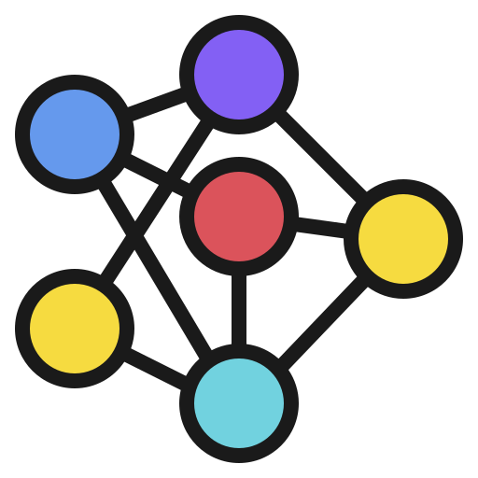
Related Work : LogME
LogME extracts features from pre-trained model and optimizes hyperparameters with a Bayesian approach to calculate the Logarithm of maximum evidence.
Not adaptive to medical images^{[1]}
Bayesian
Approach
Logarithm of Maximum Evidence
Featrues Extracted
Model Performance Score
Target Data
Pre-trained Model
[1]Chaves, Levy, et al. "The performance of transferability metrics does not translate to medical tasks." MICCAI Workshop on Domain Adaptation and Representation Transfer. Cham: Springer Nature Switzerland, 2023.
Notes:
here are two methods to assess the performance of pretrained checkpoints on downstream tasks, i.e., model transferability. The first method is a linear classifier, but it cannot be used for image segmentation tasks. The second method is fine-tuning, which is the gold standard but is inefficient due to its substantial computational resource consumption

Slide 5
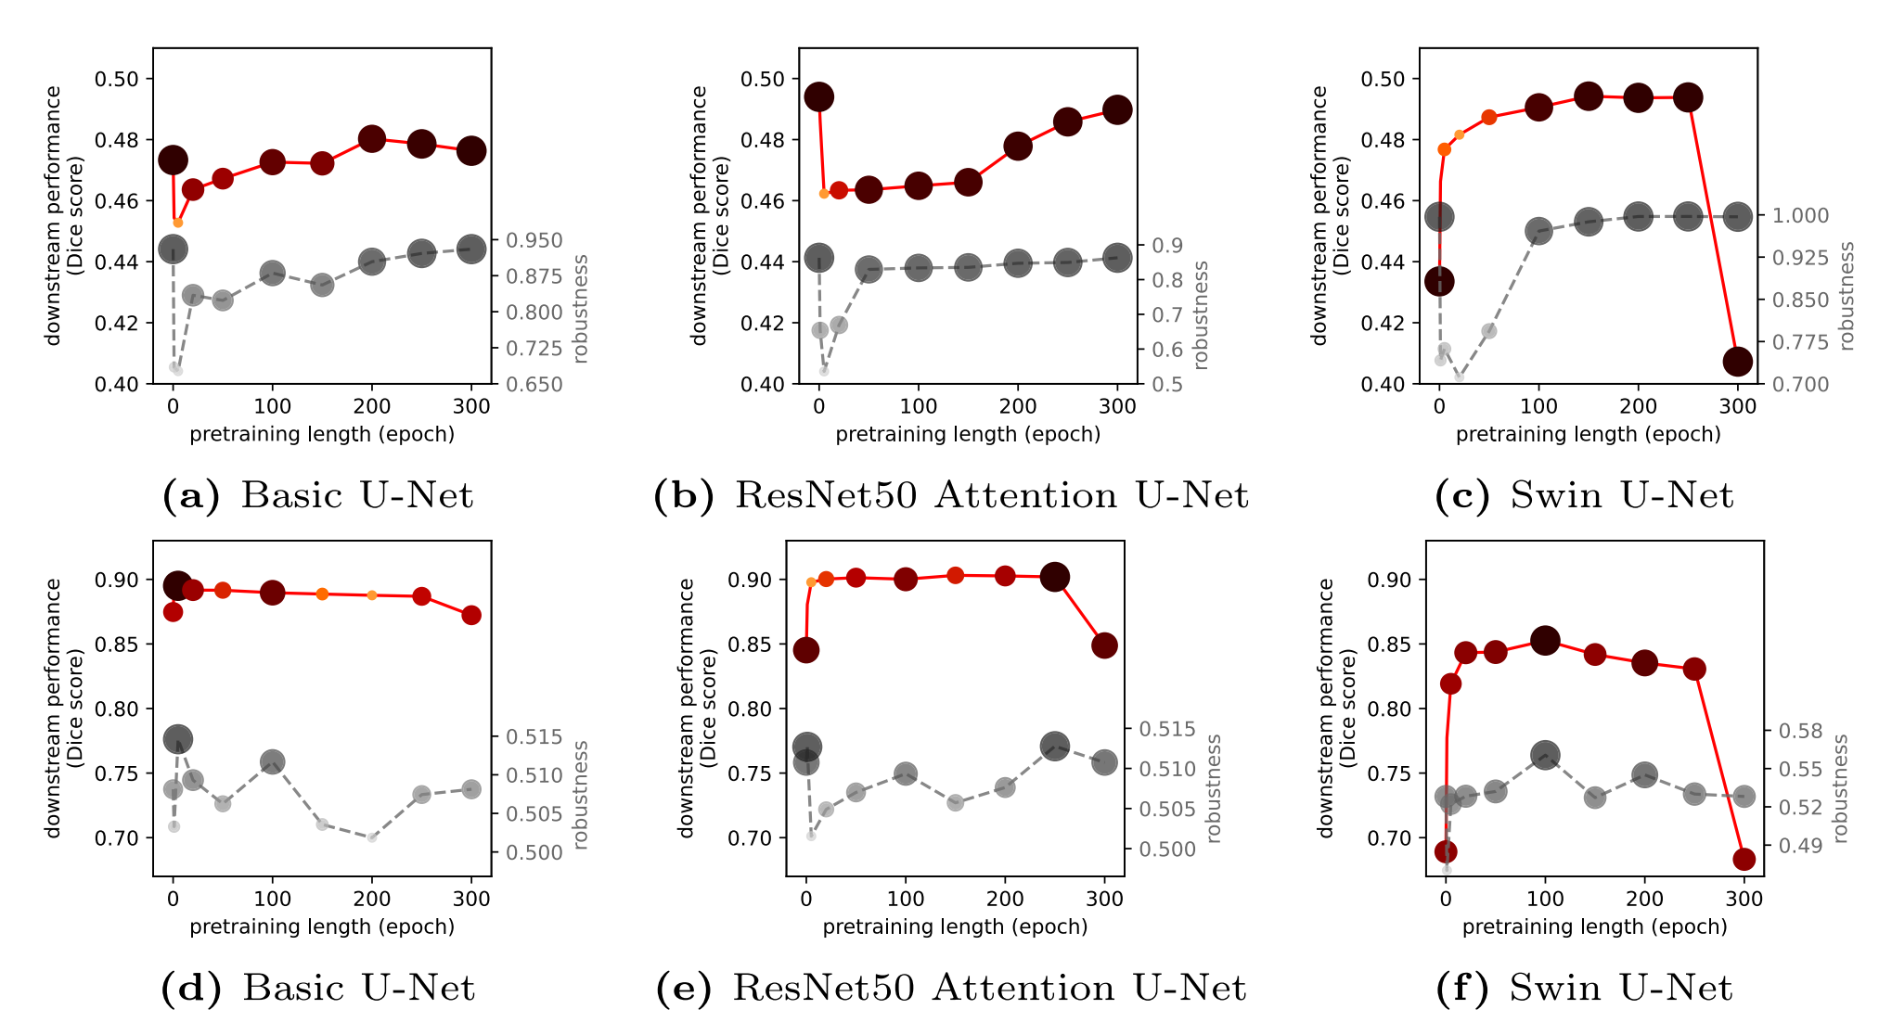
Related Work : Pretrained Models for Medical Images
When to stop pretraining to achieve the best results for pretrained models used in medical images?
Evaluating model transferability in medical images is important!
Figure2 :The relationship between the robustness and downstream performance scores of models pretrained on ImageNet and the pretraining length.
Notes:
We have done some experiments to test transferability of models. As shown in the table, we used our generic training script to load four checkpoints on the MSD prostate dataset for 5-fold cross validation. The results in the table are the average scores from the 5-fold cross validation. Since the generic training script already includes the mainstream backbones, there is no need to modify the training script when loading most checkpoints.

Slide 6

Contribution 1: Open-Source Generic Benchmark
Open-Source Generic Benchmark in 3D Image Segmentation
Adaptive to all mainstream backbones(U-Net, SegResNet, etc.)
Adaptive to all mainstream 3D image data modalities (CT, MRI, etc.)
Expected to provide 30 model checkpoints as benchmark demos
Model Zoo
Fine-Tuning
Target Data
Model Performance Ranking
Notes:
In the field of image segmentation, due to the lack of labeled data, transfer learning has become a very popular method. It efficiently utilizes limited data on downstream tasks and achieves high dice and nsd scores. However, studies have shown that not all pretrained checkpoints perform well on downstream tasks [ 24 ].

Slide 7
Contribution 2: Fast Metric
Fast Metric in 3D Image Segmentation
Expected to provide 30 model checkpoints as benchmark demos
Little time is required to rank all checkpoints
Hyperparameter-insensitive
No fine-tuning
Featrues Extracted
Model Zoo
Fast Metric
Target Data
Model Performance Ranking
Notes:
In the field of image segmentation, due to the lack of labeled data, transfer learning has become a very popular method. It efficiently utilizes limited data on downstream tasks and achieves high dice and nsd scores. However, studies have shown that not all pretrained checkpoints perform well on downstream tasks [ 24 ].

Slide 8
Argument 1: Organ -> Tumor
Verify model transferability from organ to tumor
SuPreM pretrained on an organ dataset
ULS Data is a tumor dataset
Fine-tuning
ULS Data
SuPreM (U-Net)
Fine-tuning
ULS Data
From Scratch (U-Net)
Notes:
In the field of image segmentation, due to the lack of labeled data, transfer learning has become a very popular method. It efficiently utilizes limited data on downstream tasks and achieves high dice and nsd scores. However, studies have shown that not all pretrained checkpoints perform well on downstream tasks [ 24 ].

Slide 9
Argument 2: Coarse -> Fine
Verify model transferability from aorta coarse to fine labels
SuPreM pretrained on aorta coarse labels
Aortaseg24 Data is a fine-labels dataset
Fine-tuning
Aortaseg24 Data
SuPreM (U-Net)
Fine-tuning
From Scratch (U-Net)
Aortaseg24 Data
Notes:
In the field of image segmentation, due to the lack of labeled data, transfer learning has become a very popular method. It efficiently utilizes limited data on downstream tasks and achieves high dice and nsd scores. However, studies have shown that not all pretrained checkpoints perform well on downstream tasks [ 24 ].

Slide 10
Argument 3: Add Noise to Labels
Verify the impact of label quality on model transferability.
SARAMIS Data has high-quality labels
Gaussian blurring lowers the quality of labels
Pretrain
Fine-tuning
SARAMIS Data
U-Net
Totalsegmentator Data
Pretrain
Fine-tuning
SARAMIS Data with Gaussian Blurred Labels
U-Net
Totalsegmentator Data
Notes:
In the field of image segmentation, due to the lack of labeled data, transfer learning has become a very popular method. It efficiently utilizes limited data on downstream tasks and achieves high dice and nsd scores. However, studies have shown that not all pretrained checkpoints perform well on downstream tasks [ 24 ].

Slide 11
Thank you!

